Slide 1
Kampai v1.0
Custom Kenna Connector Utility for Single or Bulk Imports
March 2019

Slide 2



Kampai Development Background
Kampai was developed with Python3 on a 32bit Ubuntu system
Current build has been ported Windows for standalone *.exe compatibility
Kampai.exe v1.0 is 5.7Mb
Key Requirements
CLI utility that connects to Kenna API with read/write capabilities
Ability to import a single vulnerability record
Ability to import multiple vulnerability records from a XLS file
Handle multiple asset types (IP, Host, URL)
“Software Security Saves Money and Improves Code Quality”

Slide 3
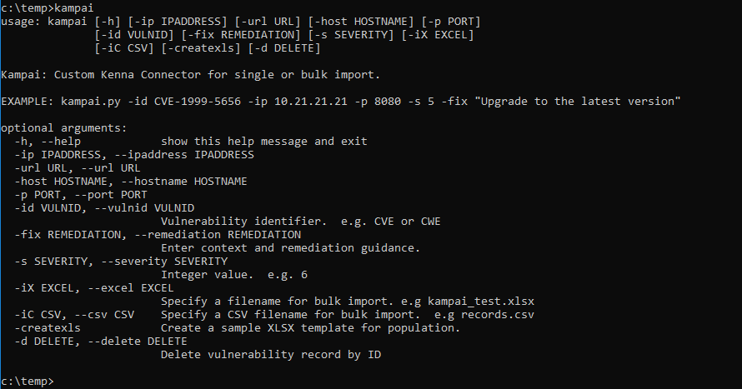
Kampai Syntax and Help on Execution
Kampai CLI Usage (Kampai.exe shown)
GUI’s are for asking, CLI’s are for telling
Easy to distribute (currently 5.7Mb)
No “installation required”
Promotes automation and operationalization
“Software Security Saves Money and Improves Code Quality”

Slide 4
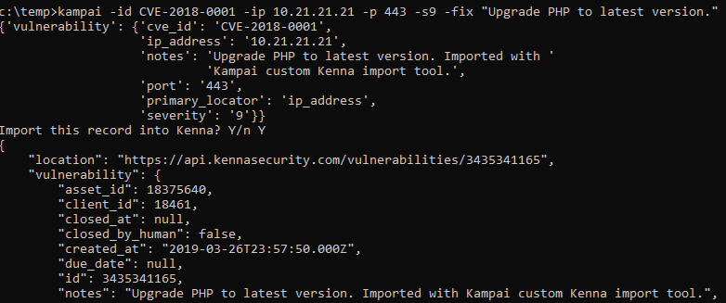
Kampai - Single Record Import
Kampai CLI Syntax for Single Record Imports
c:\> kampai.exe –id CVE-2018-0001 –ip 10.21.21.21 –p 443 –s 9 –fix “Upgrade to the latest version.”
“Software Security Saves Money and Improves Code Quality”
Notes:
Consistent adoption and implementation of program elements supporting DevSecOps
Consolidation of tools, talent, and processes to achieve productivity gains

Slide 5
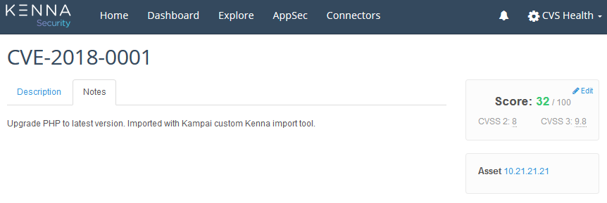
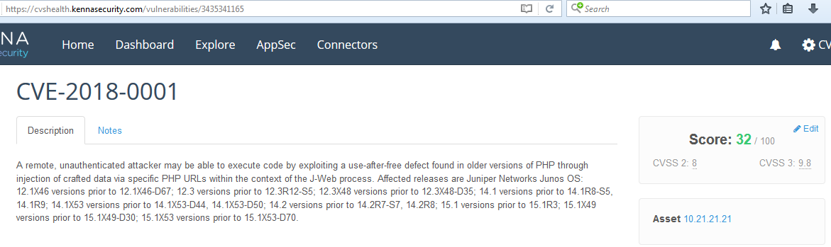
Kampai - Single Record Import
Kampai Web Interface Results
Kenna automatically populates records based on the CVE or CWE provided.
Records are found via their location ID:
http://cvshealth.kennasecurity.com/vulnerabilities/3435341165
“Software Security Saves Money and Improves Code Quality”

Slide 6
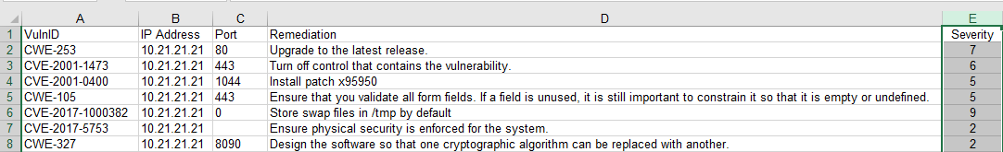
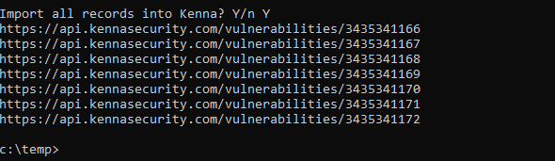
Kampai - Bulk Record Import
Kampai CLI Syntax for Bulk Record Imports
Resource File: kampai_xls.xls
c:\> kampai.exe –iX kampai_xls.xls
“Software Security Saves Money and Improves Code Quality”

Slide 7
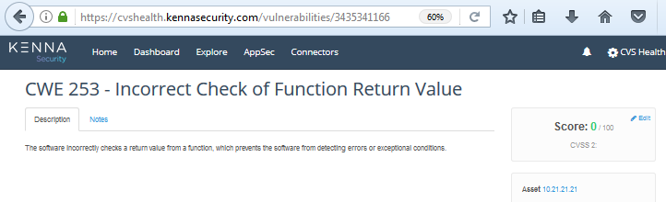
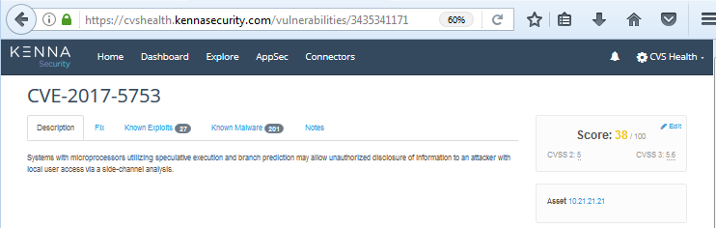
Kampai - Bulk Record Import
Kampai Web Interface Results for Bulk Imports (showing 2/7)
Kenna automatically populates records based on the CVE or CWE provided.
Records are found via their location ID:
https://cvshealth.kennasecurity.com/vulnerabilities/3435341166
https://cvshealth.kennasecurity.com/vulnerabilities/3435341171
“Software Security Saves Money and Improves Code Quality”

Slide 8
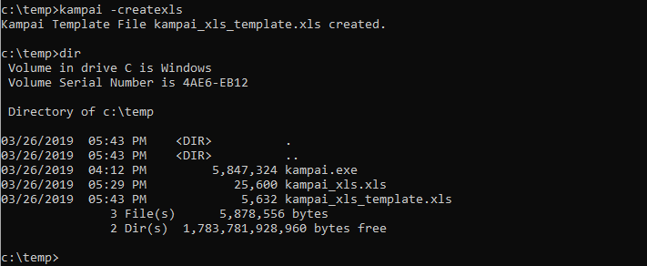
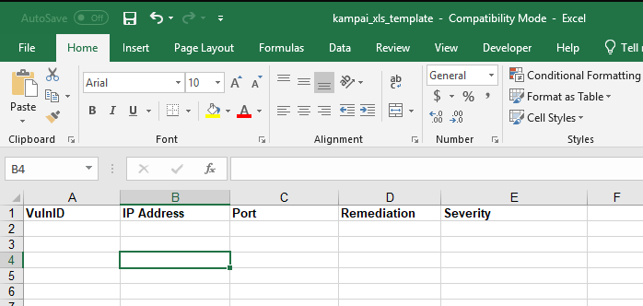
Kampai – Additional Features
Kampai Generate XLS Template for Bulk Importing
c:\> kampai.exe -createxls
“Software Security Saves Money and Improves Code Quality”

Slide 9
Kampai – Looking Forward
Kampai v2.0’s Upcoming Features
Vulnerability lookup by IP, Hostname, URL
Delete vulnerability record by location ID
Import/Status/Session HTML Report
Various bug-fixes and aesthetic changes
As well as implementing feature requests from you.
“Software Security Saves Money and Improves Code Quality”

Slide 10
Kampai – Demo
Questions?
“Software Security Saves Money and Improves Code Quality”

